Slide 1

















B2: LEDs and Plant Growth
– Science, Energy & Cost Benefits:
Dr. Matthew Davey & Martin Howes,
University of Cambridge
S-LAB 2016 PLATINUM SPONSORS
S-LAB CORE FUNDER
S-LAB PARTNERS
S-LAB 2016 GOLD SPONSORS

Slide 2
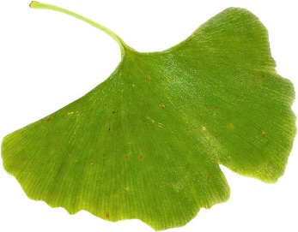

LEDs and Plant Growth
Science, Energy and Cost Benefits
Dr. Matthew Davey | Senior Research Associate
Martin Howes | Energy Co-ordinator
Notes:
LEDs and Plant Growth – Science, Energy and Cost Benefits
Dr. Matthew Davey, Senior Research Associate, and Martin Howes, Energy Co-ordinator, Department of Plant Sciences, University of Cambridge.
Lighting-related electricity consumption reduced by 60% through replacement of fluorescent tubes by LEDs in plant growth rooms, with additional benefits of reduced cooling and maintenance, and longer light lifespan.
Though the light spectra are different, plant growth trial results have shown other variables including light intensity to be more significant factors.
Similar benefits from retrofitting of algae-cultivating incubation shakers with LEDs.

Slide 3

Outline
Background
  LEDs in Plant Growth Rooms
  LEDs in Algal Growth Incubators
  Energy Savings
  Financial Case & Other Incentives
Conclusion

Slide 4
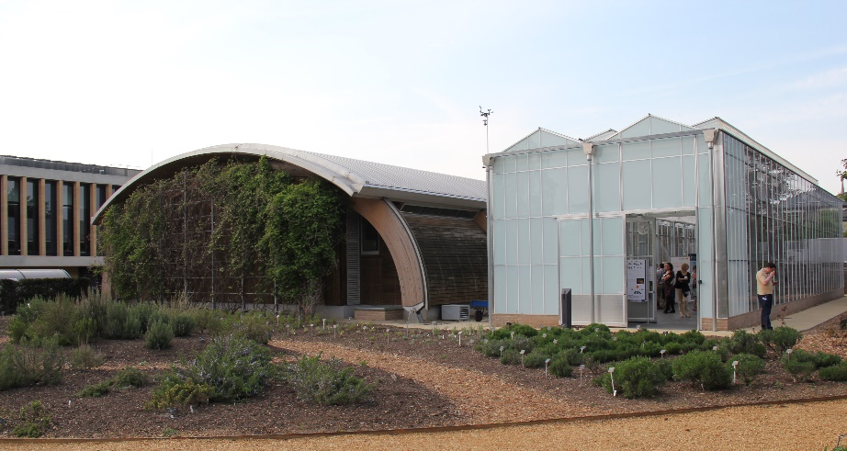
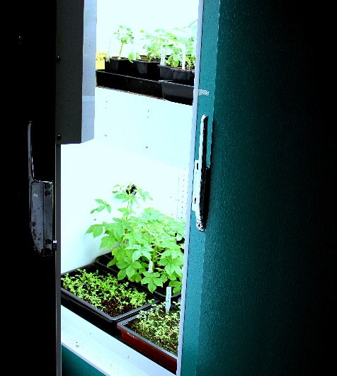
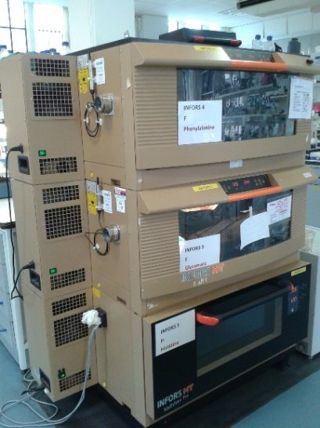
Background
Plant Sciences grows a lot of plants and algae (surprise, surprise)
Facilities range from individual pots and algal incubation shakers to growth cabinets, walk-in growth rooms and greenhouses
Significant portion of departmental electricity costs are due to plant growth lighting and climate control
Notes:
Control over light intensity, day:night cycles etc.

Slide 5
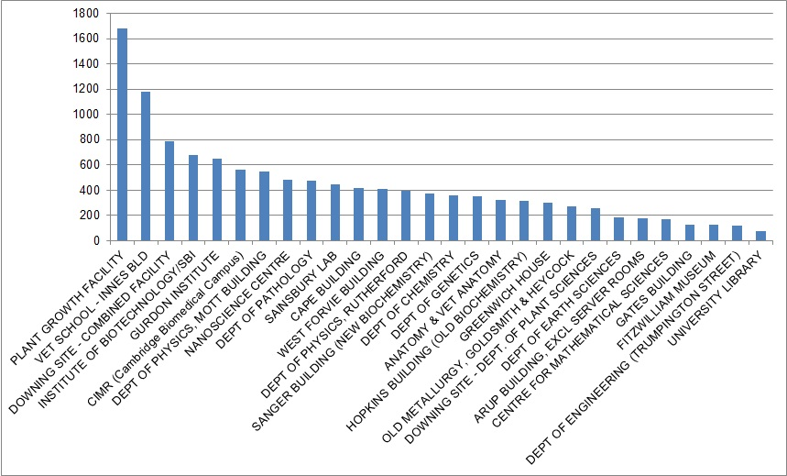
Background - Incentive
The Plant Growth Facility is the most energy intensive building of the University’s estate
PGF ~£25,000/mo PlantSci ~ £14,000/mo
1st -
Plant Growth Facility ~1680kWh/m²
21st -
PlantSci Department ~250kWh/m²
kWh/m²
Notes:
PGF – Around £25,000/mo
PlantSci – Around £14,000/mo
*YTD Average Daily Consumption £7,100kWh = £875

Slide 6
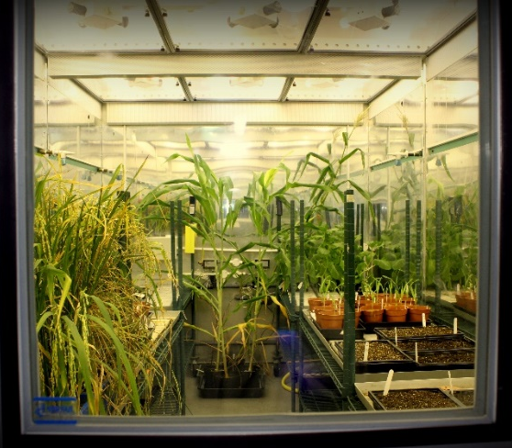
Background - Light, Climate, Energy
Plant research is dependent on high quality lighting
Critical to provide the right light intensity of the right wavelengths to the plants at the right height and evenly across shelf area
Most of the energy output from lights is heat.
In a controlled environment this must be exhausted and significant chilling costs are incurred
Notes:
Good research requires controllability of variables.
Plant research is dependent on high quality lighting capable of recreating representative growing environments.
Light has wave and particle properties.

Slide 7
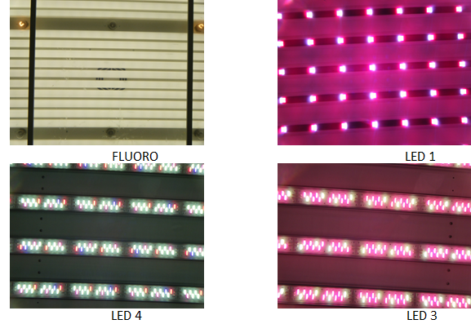
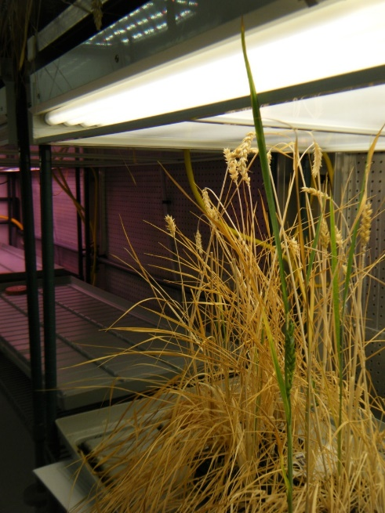
LEDs in Plant Growth Rooms
Typical ‘day load’ is 8kW per room, not-including chilling provision
16 rooms ~128kW
Trials began in 2012 with funding from the Energy & Carbon Reduction Project
Plant growth, traits need to be the SAME under LED and Fluorescent lighting in order to compare experiments
Notes:
There are sixteen PGRs with twelve trays each.
Incumbent units: 20 tubes per array, 12 arrays, 16 rooms = 180kW overnight to 400kW at peak times, averaging 290kW!= a lot of energy!
8kW per room, 16rooms = 128kW

Slide 8
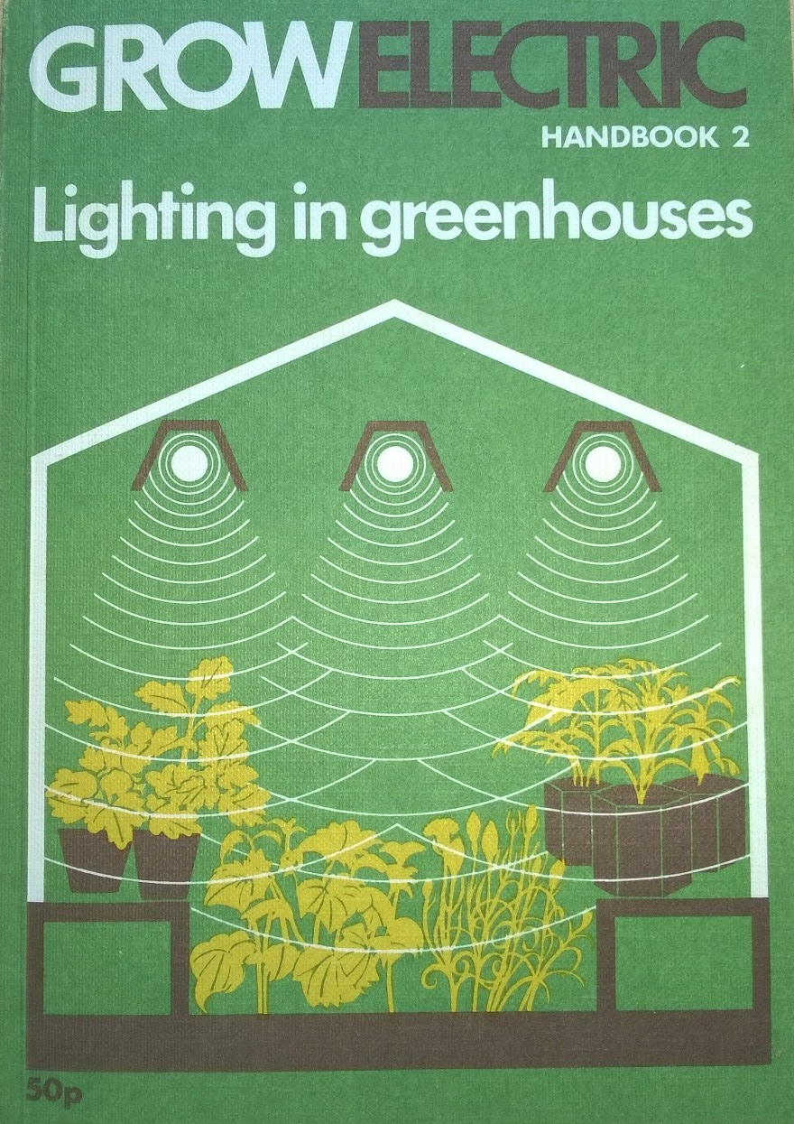
Background – 1973…
Notes:
Good research requires controllability of variables.
Plant research is dependent on high quality lighting capable of recreating representative growing environments.
Light has wave and particle properties.

Slide 9
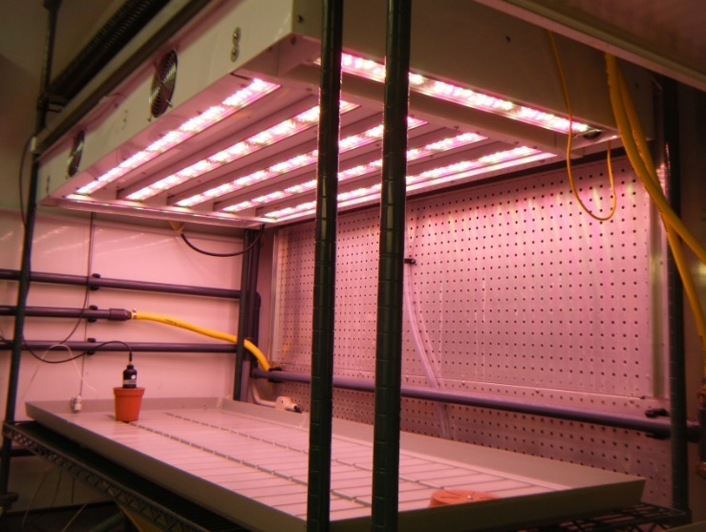
LEDs in Plant Growth Rooms
Notes:
There are sixteen PGRs with twelve trays each.
Incumbent units: 20 tubes per array, 12 arrays, 16 rooms = 180kW overnight to 400kW at peak times, averaging 290kW!= a lot of energy!
8kW per room, 16rooms = 128kW

Slide 10
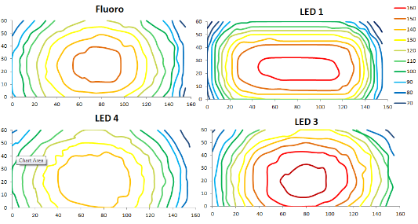
LEDs - Light Intensity & Coverage
Isophote maps show intensity of Photosynthetically Active Radiation 5cm above the surface of the growth tray.

Slide 11
LEDs - Light Spectrum
 | Fluorescent Room 6 | LED Room 7
Light Intensity Set Point | 200 µmol m² s⁻¹ | 200 µmol m² s⁻¹
Light Intensity at plant height | 177 µmol m² s⁻¹ | 180 µmol m² s⁻¹
Plant height distance from light canopy | 54cm | 53cm

Slide 12

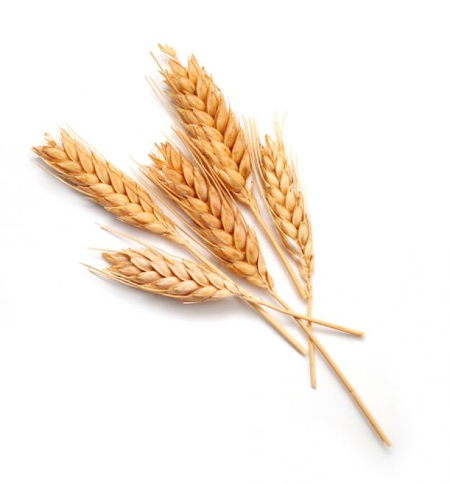


LEDs - Trials
Studied Arabidopsis, wheat, tobacco, Cleome, Setaria and tomato
CO₂ Uptake (Net, A/Ci and A/Q curves)
Chlorophyll Fluorescence and content
Growth Rate
Flowering Time
Biomass
Seed Set
Fungal Infection Rates
Recombination Rates
Effect of Red/Far-Red Ratio
Research Group Specific Plant Traits
Notes:
Metrics tested include photosynthetic rate, growth rate, chlorophyll content, seed yield, dry weight and allocation of biomass.

Slide 13
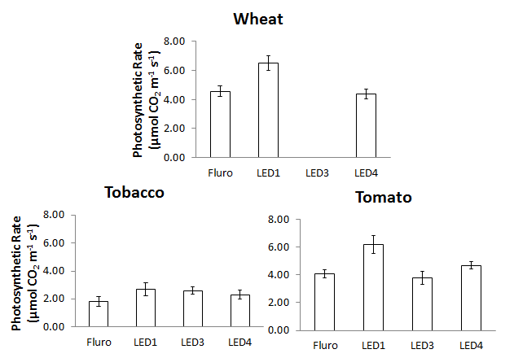
LEDs – Net photosynthesis
Notes:
Metrics tested include photosynthetic rate, growth rate, chlorophyll content, seed yield, dry weight and allocation of biomass.

Slide 14
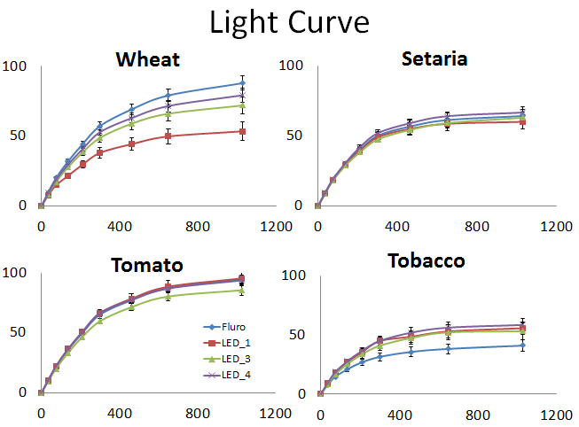
LEDs – A/Q curves photosynthesis
Notes:
Metrics tested include photosynthetic rate, growth rate, chlorophyll content, seed yield, dry weight and allocation of biomass.

Slide 15
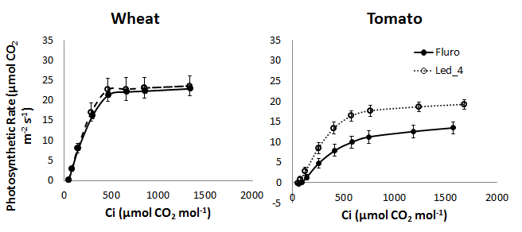
LEDs – A/Ci curves Photosynthesis
Notes:
Metrics tested include photosynthetic rate, growth rate, chlorophyll content, seed yield, dry weight and allocation of biomass.

Slide 16
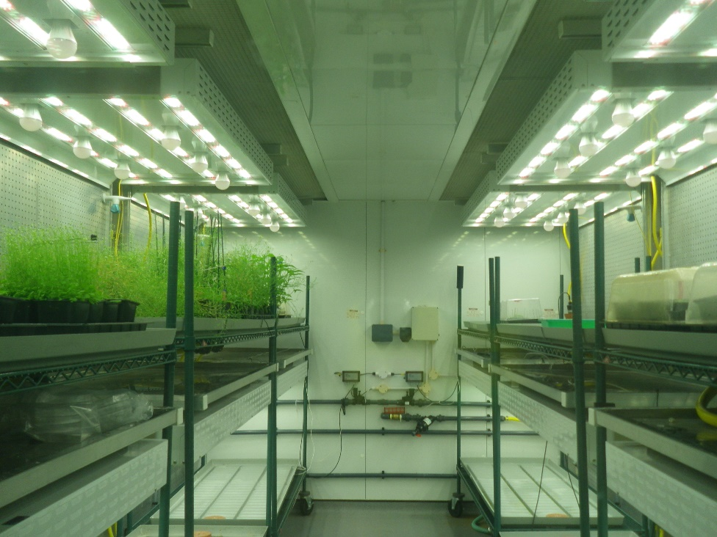
LEDs - Trials
Confident that plant growth traits are similar between light sources
Two whole rooms have been converted to LEDs
Continue monitoring and tested plants between LED and fluorescent light rooms
Notes:
Metrics tested include photosynthetic rate, growth rate, chlorophyll content, seed yield, dry weight and allocation of biomass.

Slide 17
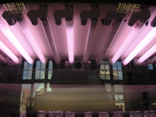
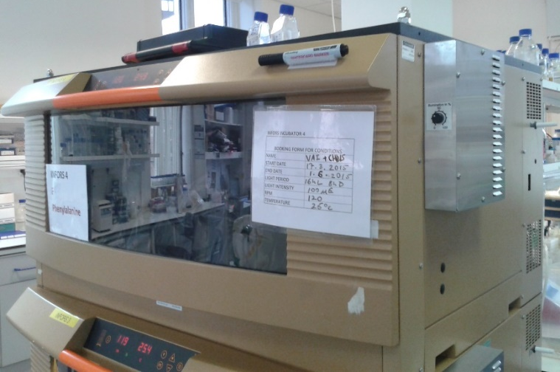
LEDs in Algal Growth Incubators
Infors Incubator Shakers are fully climate-controlled chambers for cultivating algae.
Each unit costs around £6000 per year to run in electricity and tube replacement costs.
Notes:
Three of our research groups cultivate algae.
Plant Sciences is working with Infors to develop LED.

Slide 18
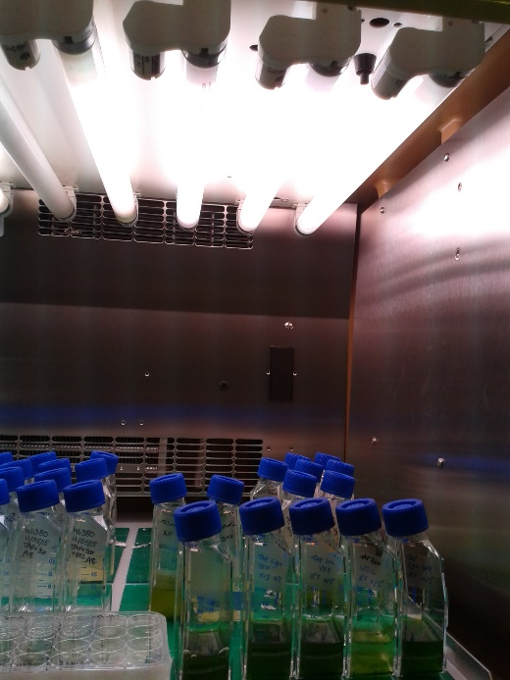
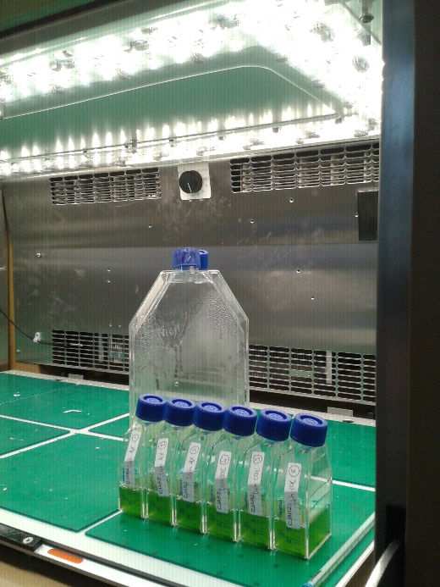
LEDs - Algae
Notes:
Metrics tested include photosynthetic rate, growth rate, chlorophyll content, seed yield, dry weight and allocation of biomass.

Slide 19
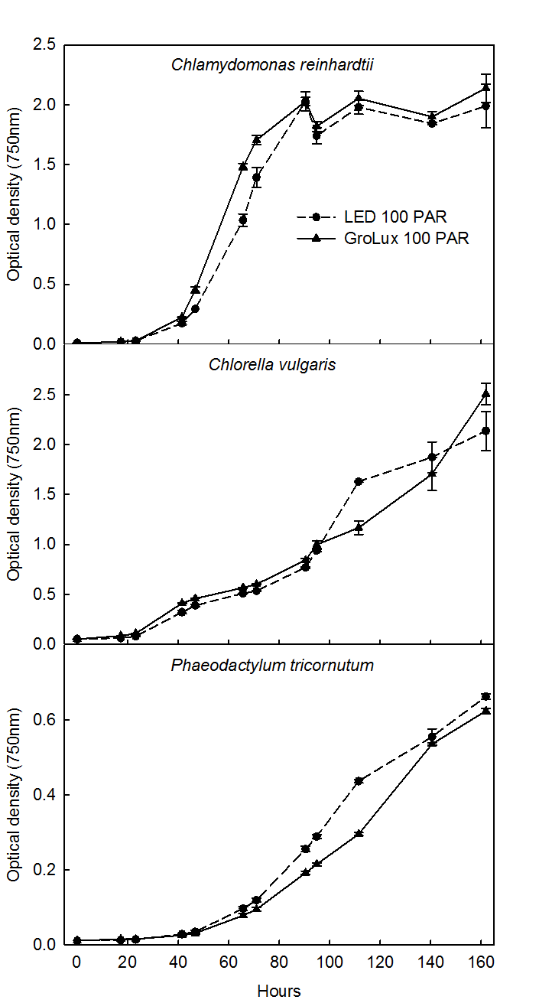
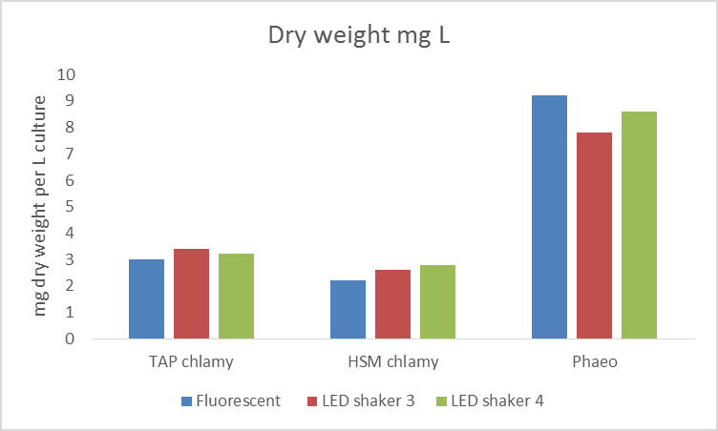
LEDs – Algal Growth
Studied Chlamydomonas, Chlorella, Phaeodactylum
Notes:
Metrics tested include photosynthetic rate, growth rate, chlorophyll content, seed yield, dry weight and allocation of biomass.

Slide 20
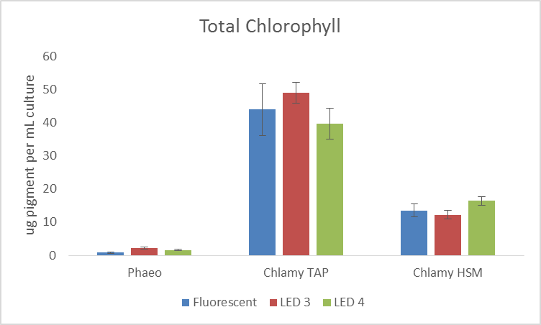
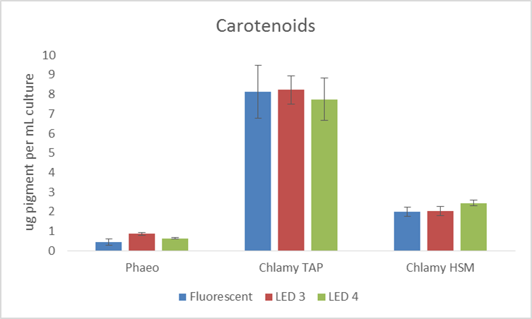
LEDs – Algal Growth
No significant differences have been found in algal growth and other traits when grown under LEDs and fluorescent lighting
Notes:
Metrics tested include photosynthetic rate, growth rate, chlorophyll content, seed yield, dry weight and allocation of biomass.

Slide 21
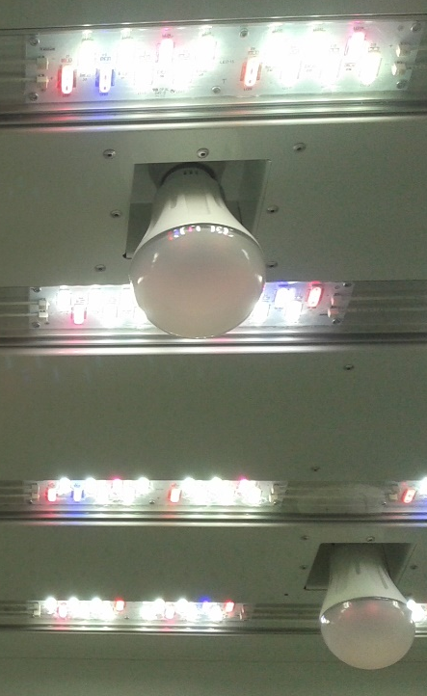
Energy Savings – Plant Growth Rooms
Unconverted and converted rooms have been metered and logged throughout trials.
60% reduction in electrical demand from lighting. A ~4kW reduction replicated across all rooms will save £60,000 per year.
Removal of heat exhaust fans reduces room baseload by 15% (twenty-four hours).
A proxy for chilling demand suggests >15% reduction. This could boost savings to £100,000 per year across all rooms.
Notes:
Research and teaching groups have been invited to experiment under the new lights. This investigation programme will define how LEDs are rolled out over the other rooms and cabinets of the Plant Growth Facility.
*UPDATE 23/05/16* - Typical room load with lights on is reduced from ~12kW to ~6.3kW, a 47.5% reduction.
0.8kW of this is a 24/7 reduction in baseload (5 to 4.2kW = 16%) as fans are not needed with the LED arrays.
Pure lighting load reduction is 4.9kW = 53%.
Room consumption not including chilling demand reduction is ~£3800/yr. Saving are higher on rooms producing higher light intensities.
Chilling load reduction is difficult to measure. The parameter we are monitoring is ‘Cool Modulating Valve’ which, when glycol supply is good, seems to have to be opened 10% less for the LED room.
Collecting electrical usage and chilling demand data under various room conditions.

Slide 22
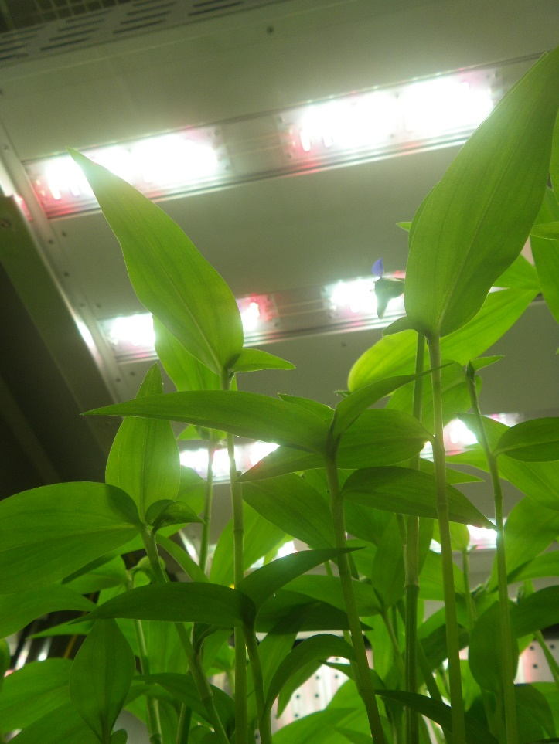
Financial Case – Plant Growth Rooms
Payback on light electricity savings alone is ~ 12 years.
This doesn’t take reduction in chiller demand and wear, light replacement costs or maintenance time into account.
Lights themselves have longer lifespans with less ‘fall-off’ in light quality with age.
Notes:
Research and teaching groups have been invited to experiment under the new lights. This investigation programme will define how LEDs are rolled out over the other rooms and cabinets of the Plant Growth Facility.
*UPDATE 23/05/16* - Typical room load with lights on is reduced from ~12kW to ~6.3kW, a 47.5% reduction.
0.8kW of this is a 24/7 reduction in baseload (5 to 4.2kW = 16%) as fans are not needed with the LED arrays.
Pure lighting load reduction is 4.9kW = 53%.
Room consumption not including chilling demand reduction is ~£3800/yr. Saving are higher on rooms producing higher light intensities.
Chilling load reduction is difficult to measure. The parameter we are monitoring is ‘Cool Modulating Valve’ which, when glycol supply is good, seems to have to be opened 10% less for the LED room.
light replacement costs – tubes and incandescents, large reduction in maintenance time spent changing spent lamps

Slide 23
Energy Savings – Algal Growth Incubators
LEDs are:
  Over twice as efficient.
  Capable of producing nearly double the light intensity.
Notes:
Capable of producing nearly double the light intensity, making the units more capable and flexible.

Slide 24
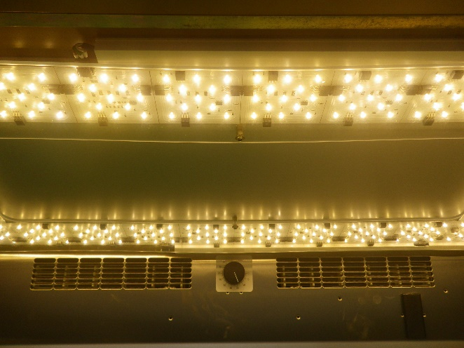
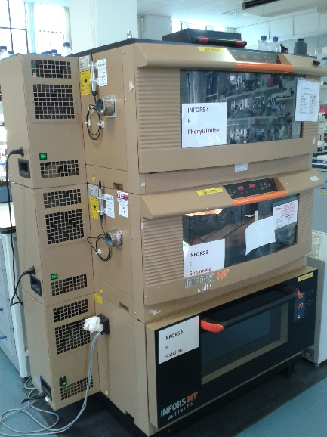
Financial Case - Algal Growth Incubators
Payback on LED retro-fit: ~8 years
Unit capability is improved.
LEDs emit less heat which reduces chilling demand. A further ~55W is saved under normal operating conditions.
Expected lifespan of the LEDs is 10x better than the tubes (10-20 years instead of 1-2 years).
Notes:
This slashes maintenance costs incurred by the research groups.

Slide 25
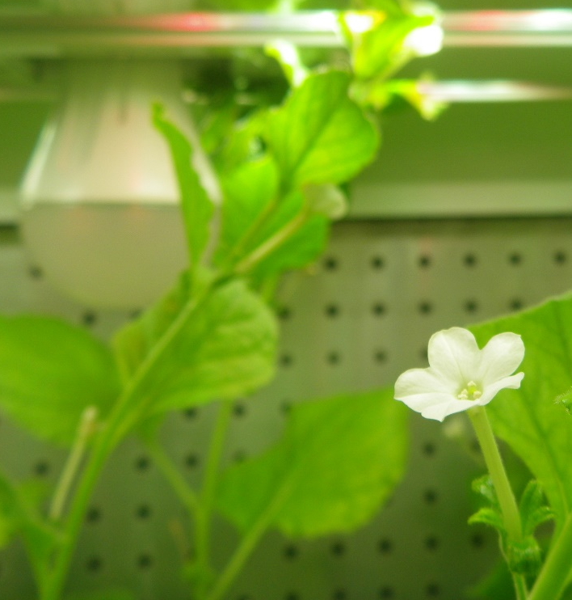
Conclusion
LED technology is maturing quickly. It is efficient, powerful and flexible.
Energy savings are significant.
There are significant other benefits for procurement and maintenance.
Research grade plant and algae growth under LED is a reality.
Notes:
The Department of Plant Sciences has sought to ensure that a switch to LED does not adversely affect research.
Conviron says that increasingly looking at multi-channel tunable LED solutions. Heliospectra would appear to be the same.

Slide 26




With thanks to:
Partners:
Energy & Carbon Reduction Project Board
Colin Denston
Sally Pidgeon
Prof. Alison Smith
Eleanor Tomsett
Ross Dennis
Simon West

Slide 27
Thank You
Questions?
Dr. Matthew Davey
Senior Research Associate
mpd39@cam.ac.uk
Martin Howes
Energy Co-ordinator
meh73@cam.ac.uk

