Slide 1

Green Reps Network Meeting
19/07/2016
Reasons for setting up a Green Reps Network
Aims of the Network
Example areas to investigate and share knowledge
What can the network do for you?
Initial Priorities & Actions

Slide 2
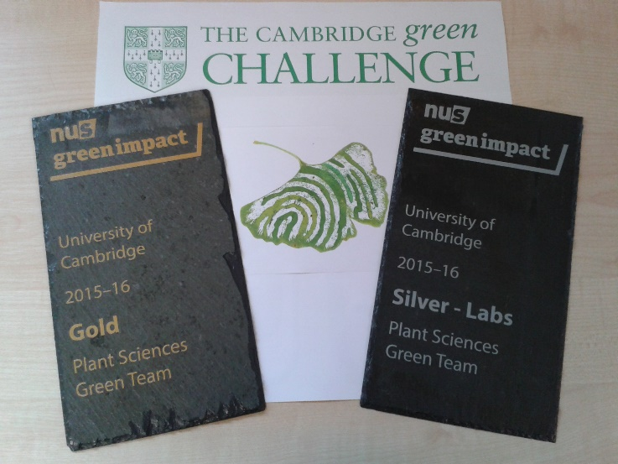

Slide 3
Metered Air Con | £ 395
IT Servers | £ 225
IT Servers Chilling | £ 125
Epidemiology Lab | £ 40
Teaching Lab | £ 85
3rd Floor Lab (inc. West Offices) | £ 380
Other | £ 1,990

Slide 5

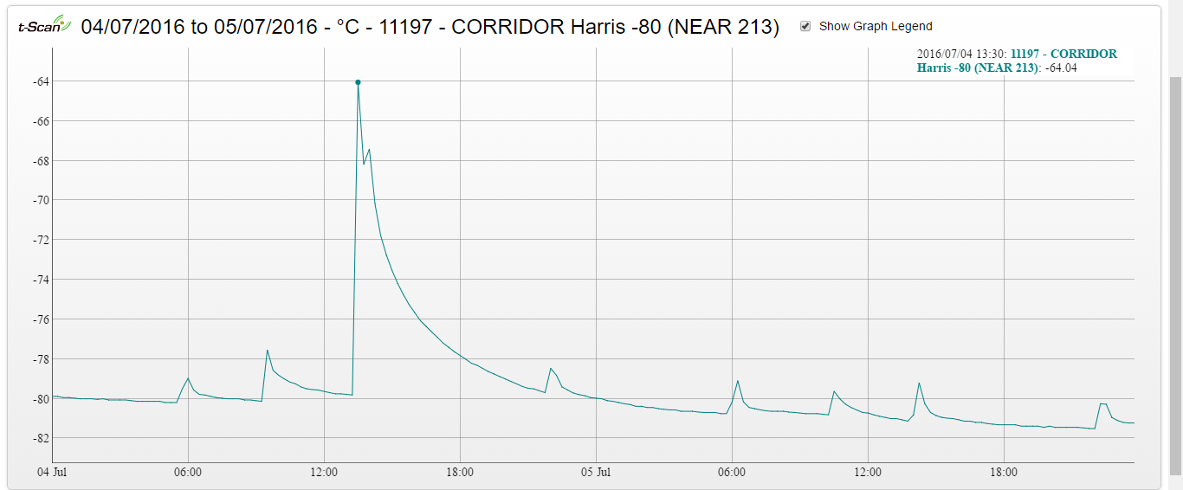
Ultra-Low temp Freezers use 9% of the building’s electricity (£16,500 per year!).

Slide 6
Modelling Hosting & Servers
Chemical Usage & Sharing
Sharing Knowledge & Good Practice
Optimising lighting, air-con
Ultra-Low Freezer Management
Travel
Equipment Booking Systems
Recycling Rates
Staff & Student Awareness/Information/Induction
Bench-top Equipment Usage & Timers

Slide 7
